Slide 1
Activation Functions in Neural Networks

Slide 2
What are Activation functions and what are it uses in a Neural Network Model?
Their main purpose is to convert an input signal of a node in an A-NN to an output signal.
Specifically in A-NN we do the sum of products of inputs(X) and their corresponding Weights(W) and apply an Activation function f(x) to it to get the output of that layer and feed it as an input to the next layer.

Slide 3
What happened if we don’t use activation function in ANN?
If we do not apply an Activation function then the output signal would simply be a simple linear function (A linear function is just a polynomial of one degree).
A linear equation is easy to solve but they are limited in their complexity and have less power to learn complex functional mappings from data.
A Neural Network without Activation function would simply be a Linear regression Model, which has limited power and does not performs good most of the times.
We want our Neural Network to not just learn and compute a linear function but something more complicated than that.

Slide 4
Why do we need Non-Linearities?
Non-linear functions are those which have degree more than one and they have a curvature when we plot a Non-Linear function.
We need a Neural Network Model to learn and represent almost anything and any arbitrary complex function which maps inputs to outputs.
Neural-Networks are considered Universal Function Approximators. It means that they can compute and learn any function at all. Almost any process we can think of can be represented as a functional computation in Neural Networks.
Hence it all comes down to this, we need to apply a Activation function f(x) so as to make the network more powerfull and add ability to it to learn something complex and complicated form data and represent non-linear complex arbitrary functional mappings between inputs and outputs. Hence using a non linear Activation we are able to generate non-linear mappings from inputs to outputs.

Slide 5
Non-Linear Activation functions

Slide 6
Non-Linear Activation Functions
Non-linear functions address the problems of a linear activation function:
They allow backpropagation because they have a derivative function which is related to the inputs.
They allow “stacking” of multiple layers of neurons to create a deep neural network. Multiple hidden layers of neurons are needed to learn complex data sets with high levels of accuracy.
Notes:
A neural network with a linear activation function is simply a linear regression model. It has limited power and ability to handle complexity varying parameters of input data.

Slide 7
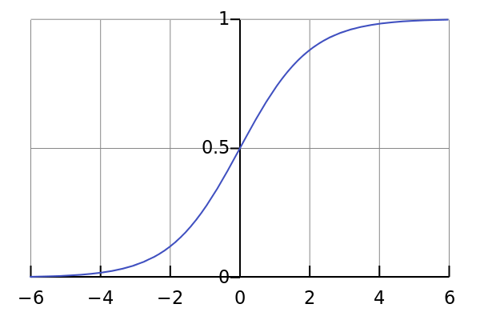

3. Sigmoid / Logistic
Smooth gradient, preventing “jumps” in output values.
Output values bound between 0 and 1, normalizing the output of each neuron.
Clear predictions—For X above 2 or below -2, tends to bring the Y value (the prediction) to the edge of the curve, very close to 1 or 0. This enables clear predictions.
Notes:
Well, this looks smooth and “step function like”. What are the benefits of this? Think about it for a moment. First things first, it is nonlinear in nature. Combinations of this function are also nonlinear! Great. Now we can stack layers. What about non binary activations? Yes, that too!. It will give an analog activation unlike step function. It has a smooth gradient too.
And if you notice, between X values -2 to 2, Y values are very steep. Which means, any small changes in the values of X in that region will cause values of Y to change significantly. Ah, that means this function has a tendency to bring the Y values to either end of the curve.
Looks like it’s good for a classifier considering its property? Yes ! It indeed is. It tends to bring the activations to either side of the curve ( above x = 2 and below x = -2 for example). Making clear distinctions on prediction.
Another advantage of this activation function is, unlike linear function, the output of the activation function is always going to be in range (0,1) compared to (-inf, inf) of linear function. So we have our activations bound in a range. Nice, it won’t blow up the activations then.
This is great. Sigmoid functions are one of the most widely used activation functions today. Then what are the problems with this?
If you notice, towards either end of the sigmoid function, the Y values tend to respond very less to changes in X. What does that mean? The gradient at that region is going to be small. It gives rise to a problem of “vanishing gradients”. Hmm. So what happens when the activations reach near the “near-horizontal” part of the curve on either sides?
Gradient is small or has vanished ( cannot make significant change because of the extremely small value ). The network refuses to learn further or is drastically slow ( depending on use case and until gradient /computation gets hit by floating point value limits ). There are ways to work around this problem and sigmoid is still very popular in classification problems.

Slide 8
3. Sigmoid / Logistic
Vanishing gradient—for very high or very low values of X, there is almost no change to the prediction, causing a vanishing gradient problem. This can result in the network refusing to learn further, or being too slow to reach an accurate prediction.
Notes:
Well, this looks smooth and “step function like”. What are the benefits of this? Think about it for a moment. First things first, it is nonlinear in nature. Combinations of this function are also nonlinear! Great. Now we can stack layers. What about non binary activations? Yes, that too!. It will give an analog activation unlike step function. It has a smooth gradient too.
And if you notice, between X values -2 to 2, Y values are very steep. Which means, any small changes in the values of X in that region will cause values of Y to change significantly. Ah, that means this function has a tendency to bring the Y values to either end of the curve.
Looks like it’s good for a classifier considering its property? Yes ! It indeed is. It tends to bring the activations to either side of the curve ( above x = 2 and below x = -2 for example). Making clear distinctions on prediction.
Another advantage of this activation function is, unlike linear function, the output of the activation function is always going to be in range (0,1) compared to (-inf, inf) of linear function. So we have our activations bound in a range. Nice, it won’t blow up the activations then.
This is great. Sigmoid functions are one of the most widely used activation functions today. Then what are the problems with this?
If you notice, towards either end of the sigmoid function, the Y values tend to respond very less to changes in X. What does that mean? The gradient at that region is going to be small. It gives rise to a problem of “vanishing gradients”. Hmm. So what happens when the activations reach near the “near-horizontal” part of the curve on either sides?
Gradient is small or has vanished ( cannot make significant change because of the extremely small value ). The network refuses to learn further or is drastically slow ( depending on use case and until gradient /computation gets hit by floating point value limits ). There are ways to work around this problem and sigmoid is still very popular in classification problems.

Slide 9
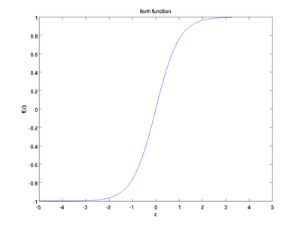
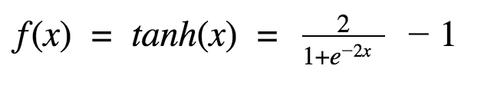
4. Tanh Function
Tanh is also a very popular and widely used activation function.
It is nonlinear in nature
It is bound to range (-1, 1)
the gradient is stronger for tanh than sigmoid ( derivatives are steeper)
Deciding between the sigmoid or tanh will depend on your requirement of gradient strength.
Like sigmoid, tanh also has the vanishing gradient problem.

Slide 10
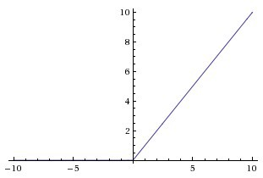
5. ReLu
ReLu is nonlinear in nature.
ReLu’s output is max(0,x) i.e it gives an output x if x is positive and 0 otherwise.
The range of ReLu is [0, inf).
ReLu is less computationally expensive than tanh and sigmoid because it involves simpler mathematical operations.
The Dying ReLU problem—when inputs approach zero, or are negative, the gradient of the function becomes zero, the network cannot perform backpropagation and cannot learn.
Notes:
How ReLu in not linear?
The simple answer is that ReLU output is not a straight line, it bends at the x-axis.
In mathematics a function is considered linear whenever a fucntion f:A→B if for every x and y in the domain A has the following property: f(x)+f(y)=f(x+y)f(x)+f(y)=f(x+y).
Assuming for simplicity that let's try x=-5, y=1 with f being the ReLU function:
f(-5 + 1) = f(-4) = 0 ≠ f(-5) + f(1) = 0 + 1 = 1
Because of the horizontal line in ReLu( for negative X ), the gradient can go towards 0. For activations in that region of ReLu, gradient will be 0 because of which the weights will not get adjusted during descent. That means, those neurons which go into that state will stop responding to variations in error/ input ( simply because gradient is 0, nothing changes ). This is called dying ReLu problem. This problem can cause several neurons to just die and not respond making a substantial part of the network passive. There are variations in ReLu to mitigate this issue by simply making the horizontal line into non-horizontal component . for example y = 0.01x for x<0 will make it a slightly inclined line rather than horizontal line. This is leaky ReLu. There are other variations too. The main idea is to let the gradient be non zero and recover during training eventually.

